Slide 1
ALPLOG NORTH AUSTRIA
StaTUS & D E V E L O P M E N T P O T E N T I A L

Slide 2
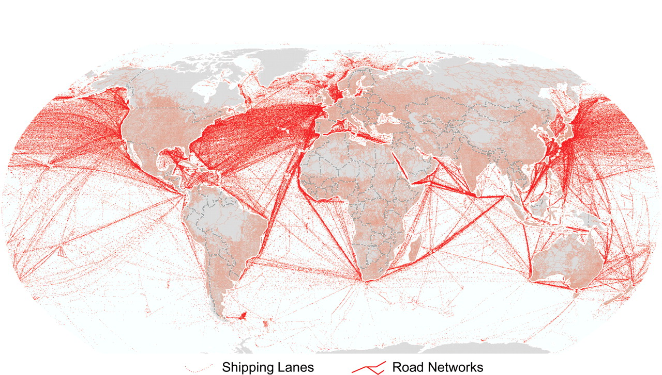
Traffic in goods - worldwide

Slide 3
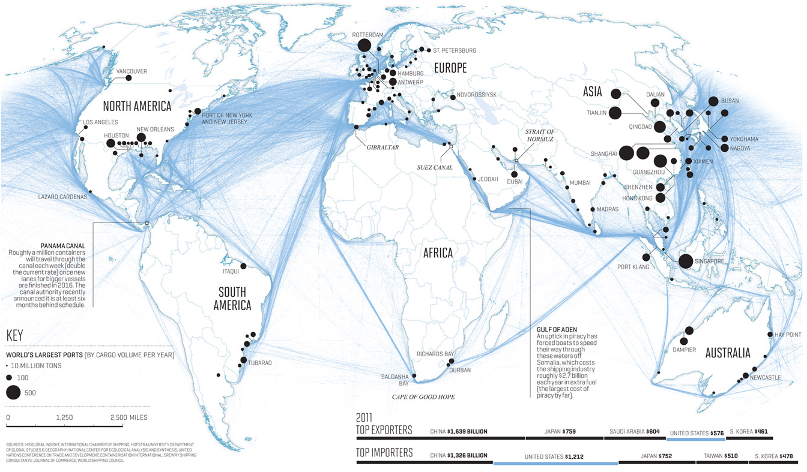

Slide 4
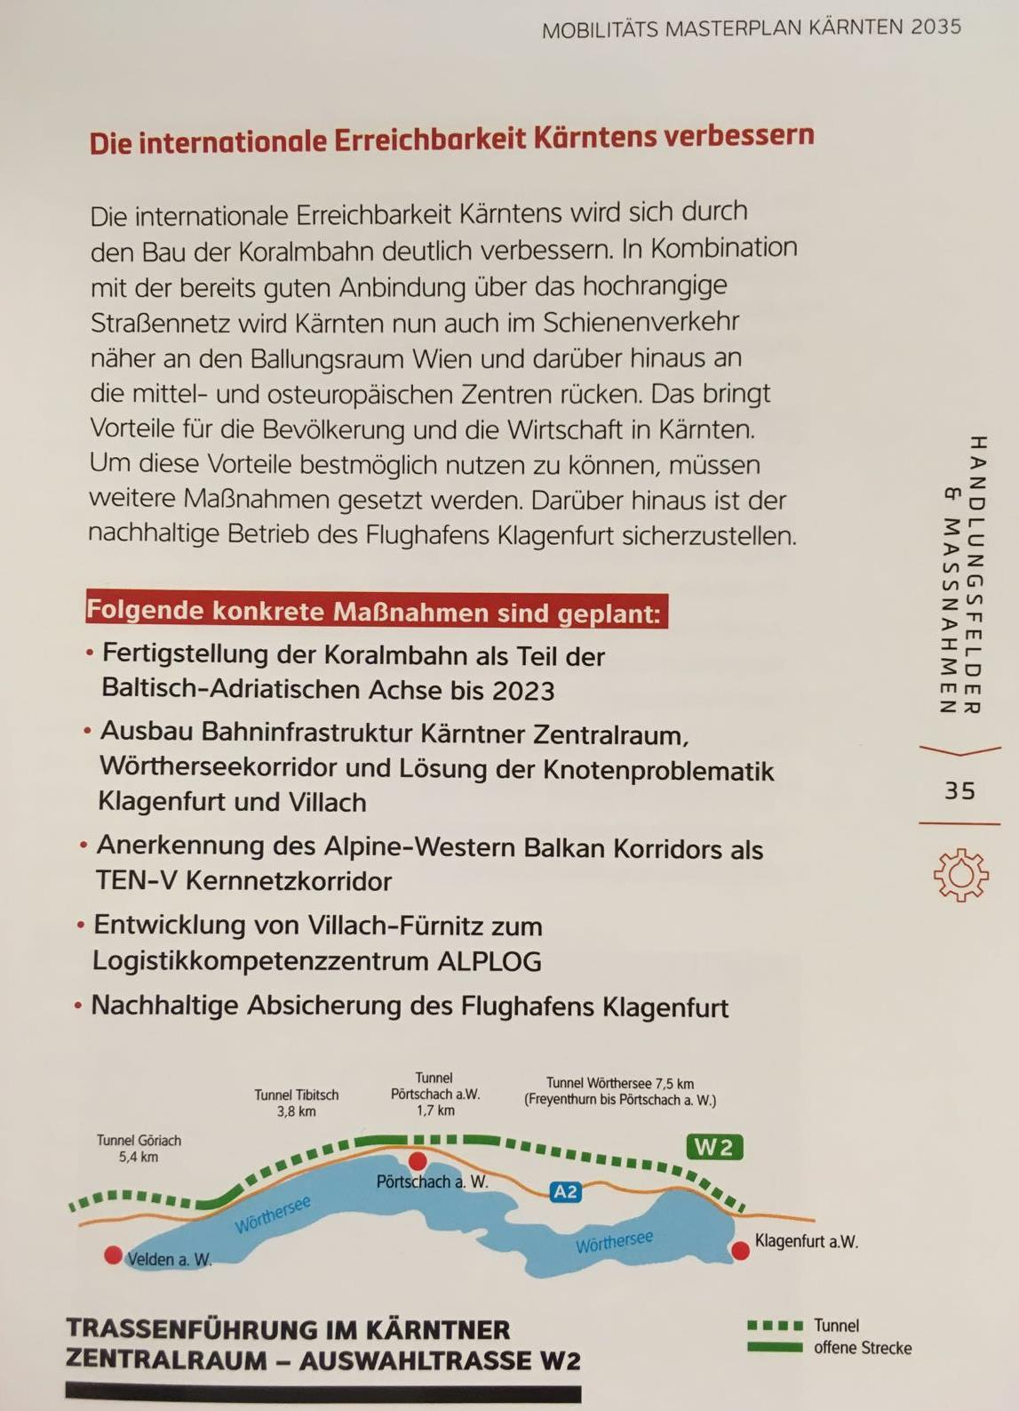
Planned topics supporting AlpLOG

Slide 5
NAPA Location Villach
NAPA – North Adriatic Port Association
Harbors in Triest, Venecia, Montfalcone, Ravenna (I), Koper (Slo), Pula und Rijeka (Cro)
Less transport costs:
25% Asia – central Germany
50% Africa – Central Germany
Compared to Hamburg, Bremen (D) or Rotterdam (NL)

Slide 6
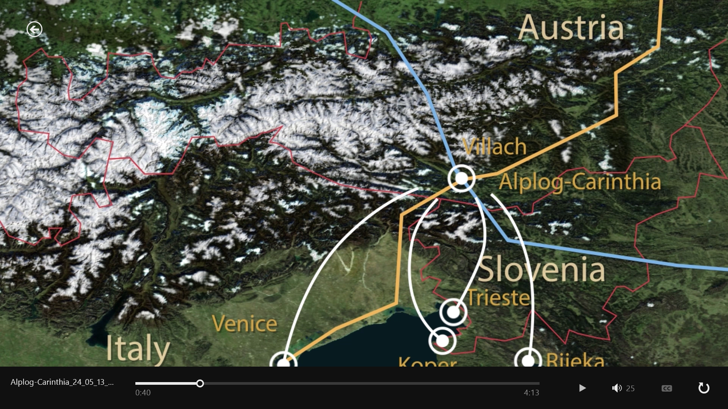
LOGISTIC CENTER NAPA harbors

Slide 7
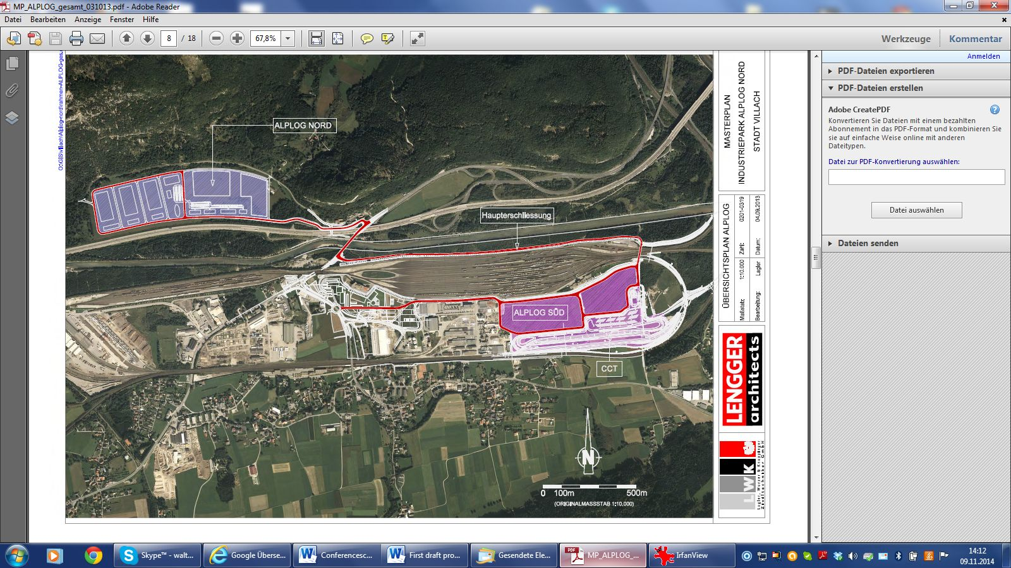
ALPLOG [North - South]

Slide 8
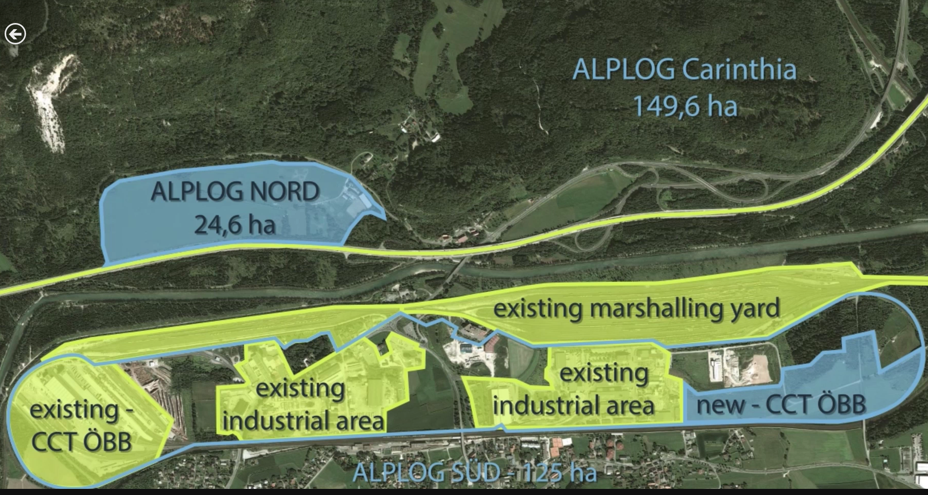
Development - Status

Slide 9
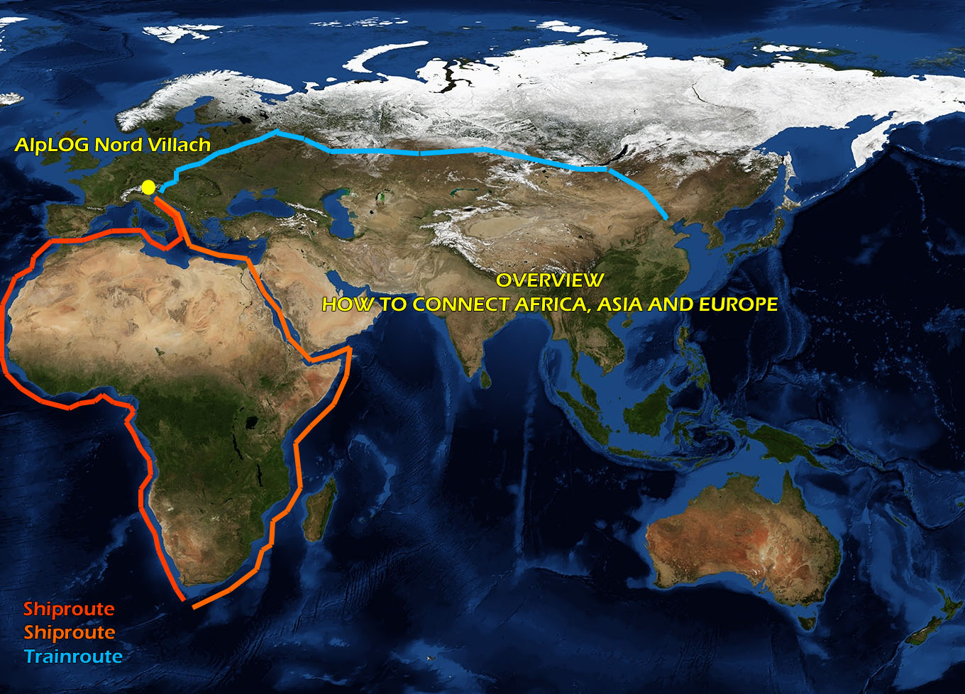
HOW TO CONNECT AFRICA, ASIA AND EUROPE
Shiproutes from Asia several possibilities
Roadnetwork to Asia via Silkroad plans
Via Russia
Connection to the narrow european railway network
With the wider russian network in vienna planned
Dryporthub in Villach – AlpLOG North – is the second biggest railwaystation in Austria beside vienna in only 100 km behind the north adriatic harbors in Italy (Trieste, Mont Falcone, …..), Slovenia (Coper), Croatia (Rijeka…..)

Slide 10
Development Plan
Environmental dedication: done
General dedication to industrial land: done
Customs free zone: agreed
Ownership-organisation: strengthen assets
Working-organisation: marketing and run
Segmentation:
Production / Assembling
Logistics
Education / Innovation
Services
Step by step financing / Phases / Zones
Time frame 1-3 years

Slide 11
Ownership situation AlpLOG North

Slide 12
INDUSTRIES
Industries
Food, Agricultural Products,
Machinery
ICT (existing enterprises – logistic focus)
Logistic
Precious metal – stocking and refinement
Travel / recreation
„Autohof“
Services / Advise / Finance
bank
Tax / Trust
Customerstructure planned

